Slide 1


Keeping Secrets in Azure
Azure Saturday Belgrade 2021
for .NET Developers
Zoran Horvat
Principal consultant at Coding Helmet
http://codinghelmet.com
zh@codinghelmet.com
zoranh75

Slide 2


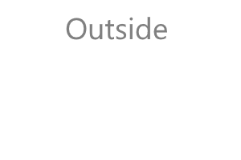



A Word on Safety…
“Keep it secret. Keep it safe." – Gandalf
Pilot Timothy Lancaster, 1990

Slide 3




Big thanks to our sponsors

